Slide 1
Football Data Analysis
Project
By: Kanav Khanna

Slide 2
Aim: To predict the winner of a match in the English Premier League

Slide 3
Step 1: Collecting and studying Premier League data of past 25 years.

Slide 4
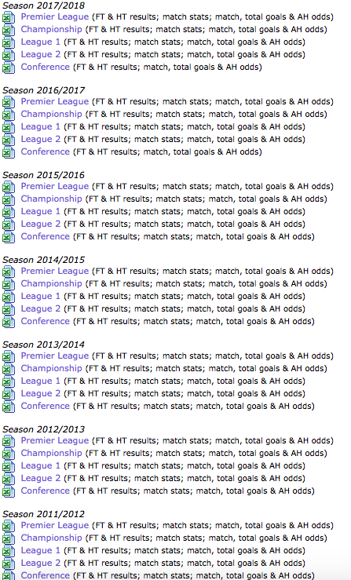

Slide 5
Step 2: Determining the parameters that weigh the most for a team to win.
After studying the datasets of the matched over the last 25 years, I deduced goals scored, shots taken, shots on target, corners taken, fouls received by each team as the parameters to compare.

Slide 6
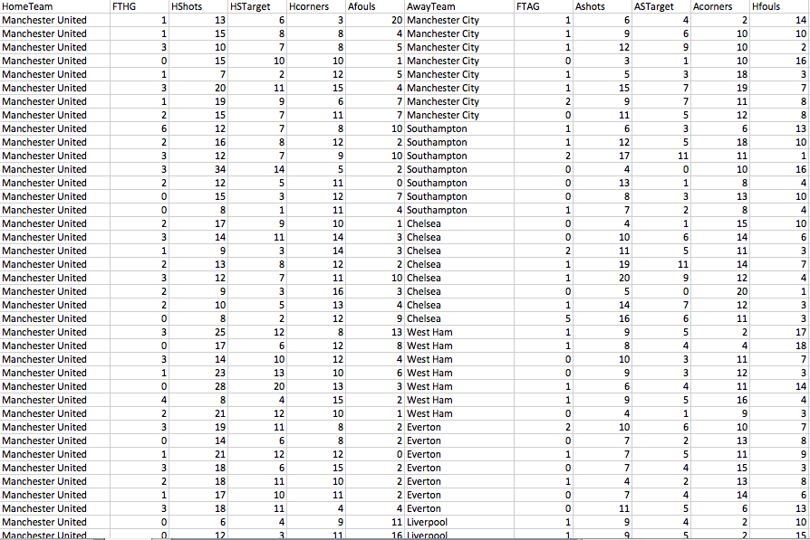

Slide 7
Step 3: Writing the algorithm
To compare two teams, I first analyzed the performance of each team in all its matches against all the teams over the years. On combining the values of all of the parameters of the team in a match, I calculated the team’s ‘form’ in every match. This way I combined the form of the team in all the matches to give the team a ‘Final Form’.
I then compared this Final Form to the Final form of the other team to determine the winner.

Slide 8
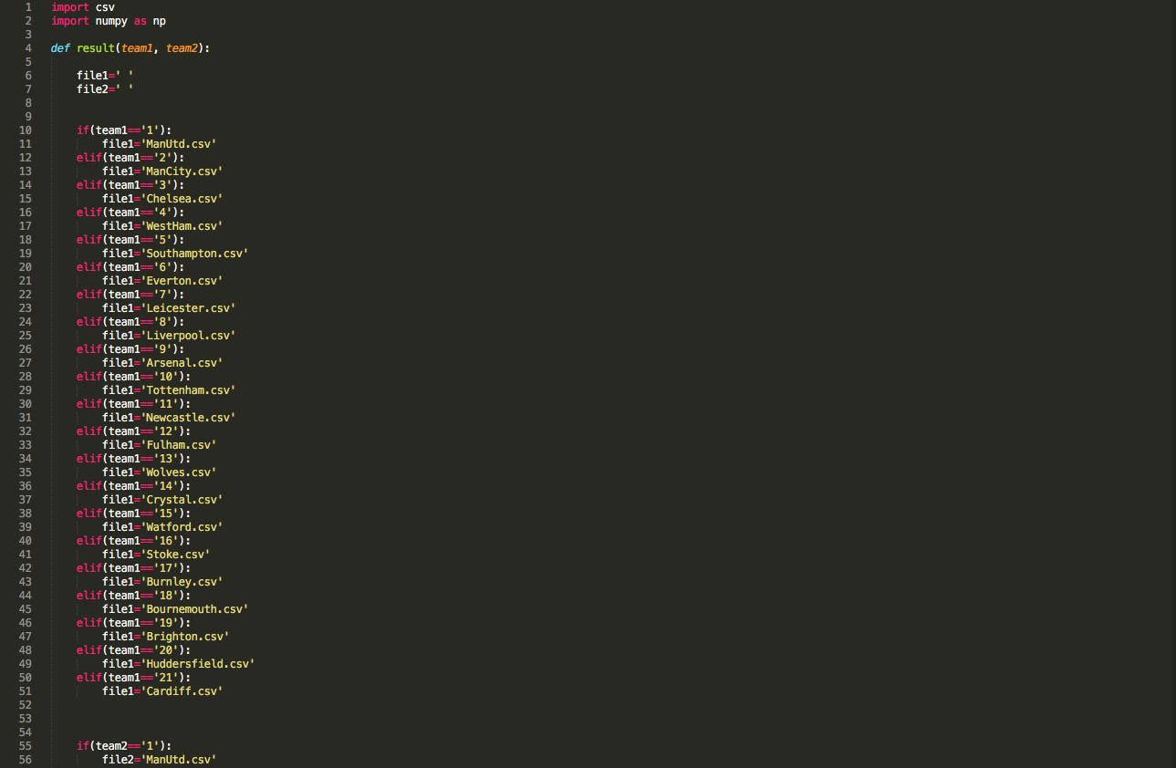

Slide 9
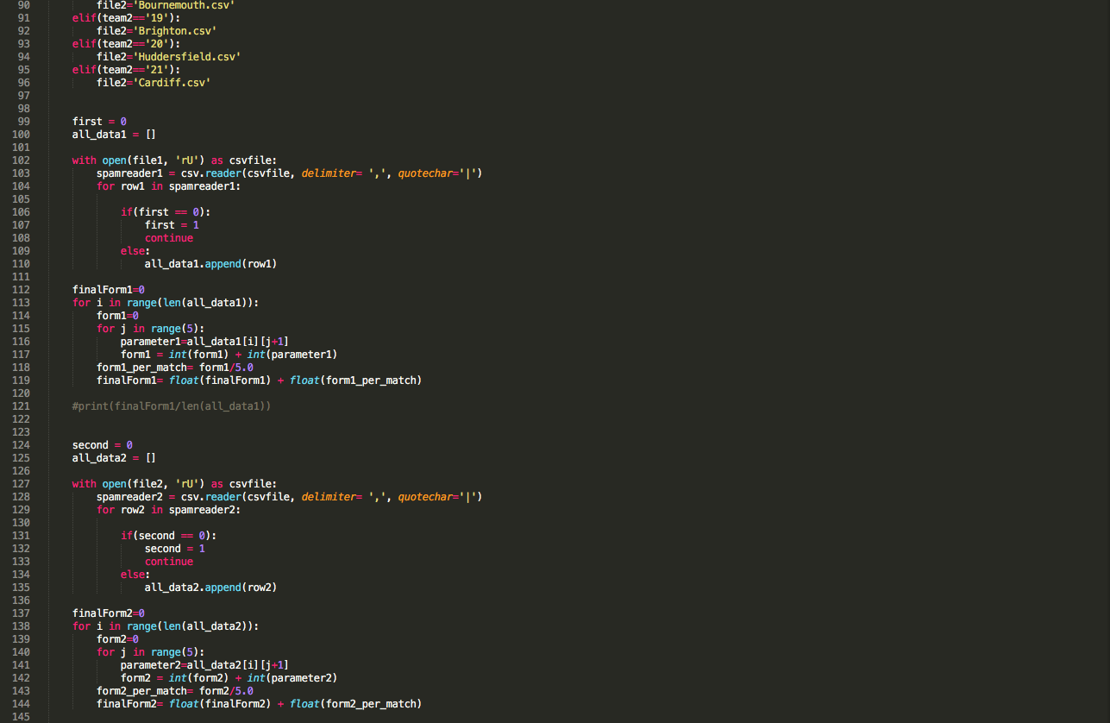

Slide 10
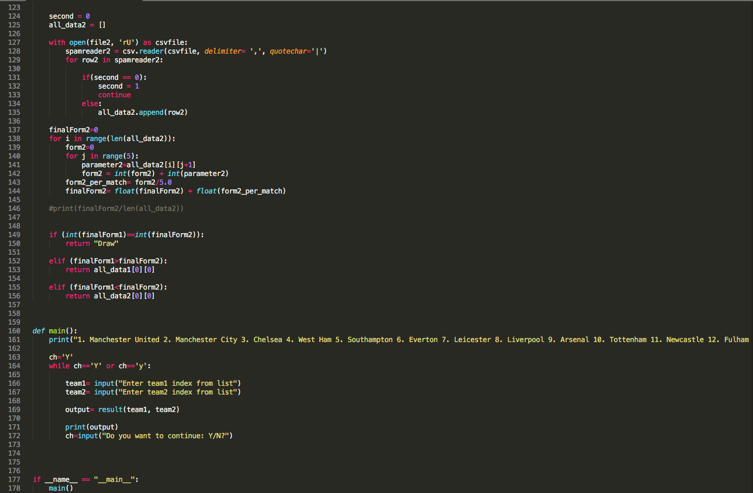

Slide 11
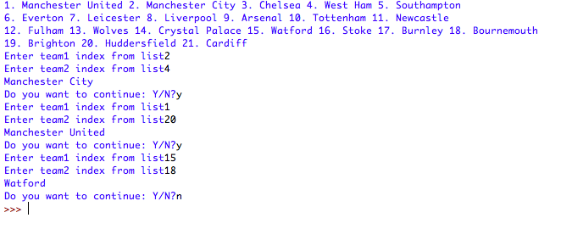
Output

